Slide 1
DESIGN RULES – part 1
Session 5

Slide 2
Let us learn the instructions. But, with some design rules in place.
A question that anyone can answer is to be asked.
Can I speak with you in Latin and will you understand (Assuming you do not know Latin)?
Answer is overt. And yes, you wont understand.
Hence, it is important to communicate to someone in the language he/she understands.
What is computer’s language?
Undoubtedly, it is instructions.
All instructions are grouped under one housing unit called Instruction Set. What we will see in this chapter?
So, what next?
We should learn how to talk to a computer and how computer could interpret it as well.
We can cite this as “Secret of Computing”.

Slide 3
MIPS writing / representation notations (This is like the coding guidelines)
We can take / cite some addition operation in this section to get the understanding constructed, solid.
Addition is the operation which we shall talk about as it is much easier and straight forward than anything else.
The instruction could be – add x, y, z
What this does?
Simple, add y and z. Store the result in X.
This is called MIPS representation.
Can we have any other notation to represent MIPS?
Come on. Not possible.
Extremely inflexible when it comes to MIPS.
Each operation will have 3 operands for sure. (means X, Y, Z)
Also, each operation could only perform one operation.
Means, it is addition. Only addition.
MSD is a batsman. No bowler. One action!

Slide 4

Lets add some fun…
Challenge – add the values at Q R S T registers and place the result in P.
How MIPS could do this?
Considering the restrictions thrown in the previous slide, we should get a solution.
Thus, we require 3 instructions to add 4 numbers (Costly, huh??)
MIPS guidelines say, each line can have one instruction, the max.
Comments always terminate at end of the line.
Just, MIPS things.

Slide 5


Fantastic Four – Design Rules
Rule 1 – Keep it simple. (Referred as Simplicity offers Regularity)
It is all simple with MIPS. We can now do something interesting.
This is C Programming approach…
The MIPS way..
Inference: Directly we mapped!

Slide 6
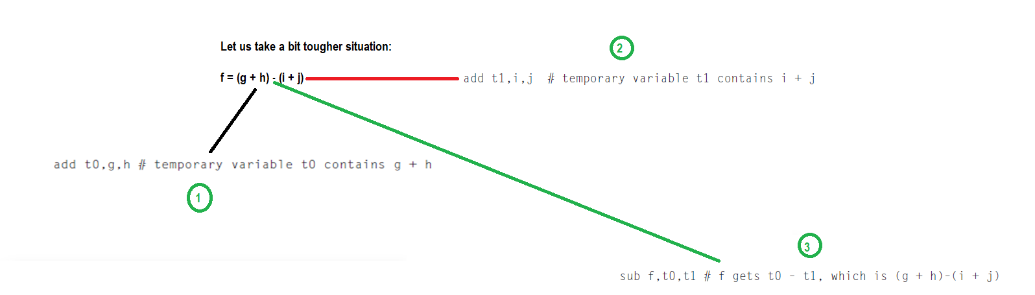
Contd.,
So it is easy with MIPS. Simplicity rendered to perform operations as good as it is in high level languages is an added advantage.

Slide 7
Lets go a bit deeper…
C or CPP has a facility which MIPS does not have. That is, storage luxury.
There are very limited storage options and register’s usage is inevitable.
Registers are going to be the heart, kidney and liver.
They are termed even as bricks of computer organization.
As discussed earlier, the size of MIPS registers is 32 bits.
In MIPS architecture, 32 bits together is termed as WORD.
A register is capable of storing a word is the point to be taken.

Slide 8
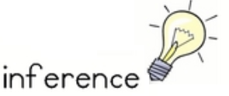
Inference
MIPS has 32 registers. (Everything is 32 here!)
So what?
We have added the restriction that the three operands of MIPS arithmetic instructions must each be chosen from one of the 32 32-bit registers.

Slide 9
Rule – 2 Make it smaller (As it would be faster)
If more number of registers are there, it would need more clock cycle time.
Why?
Simple. It will take electronic signals longer when they have to travel farther.
Also, 31 Registers may not be faster than 32 ☺
There are notations to be followed in MIPS architecture.
$ is used to represent a register.
$s0, $s1 → For Registers.
$t0, $t1 → Temp
clock cycle is the time between two adjacent pulses of the oscillator that sets the tempo of the computer processor.

Slide 10
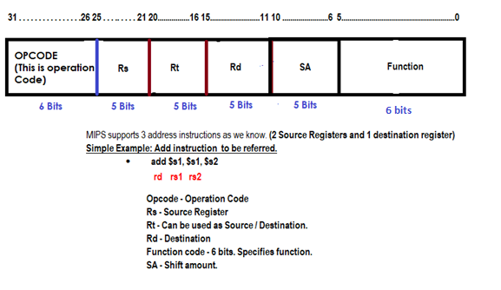
Let us learn what R Type instructions are all about!!! Fun Ride!!!!
For R Type Instruction Remember the following stuff:
OPCODE IS ALWAYS 0.
“add” and “sub” both are R type instructions. Opcode for both of them is 0.
Compiler would differentiate the operations based on the function field (Operation code).

Slide 11
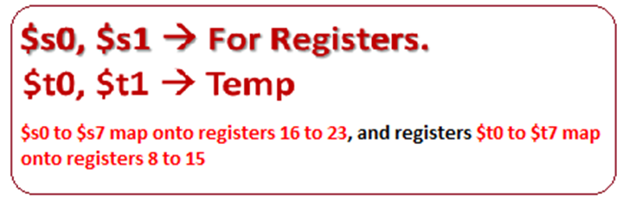
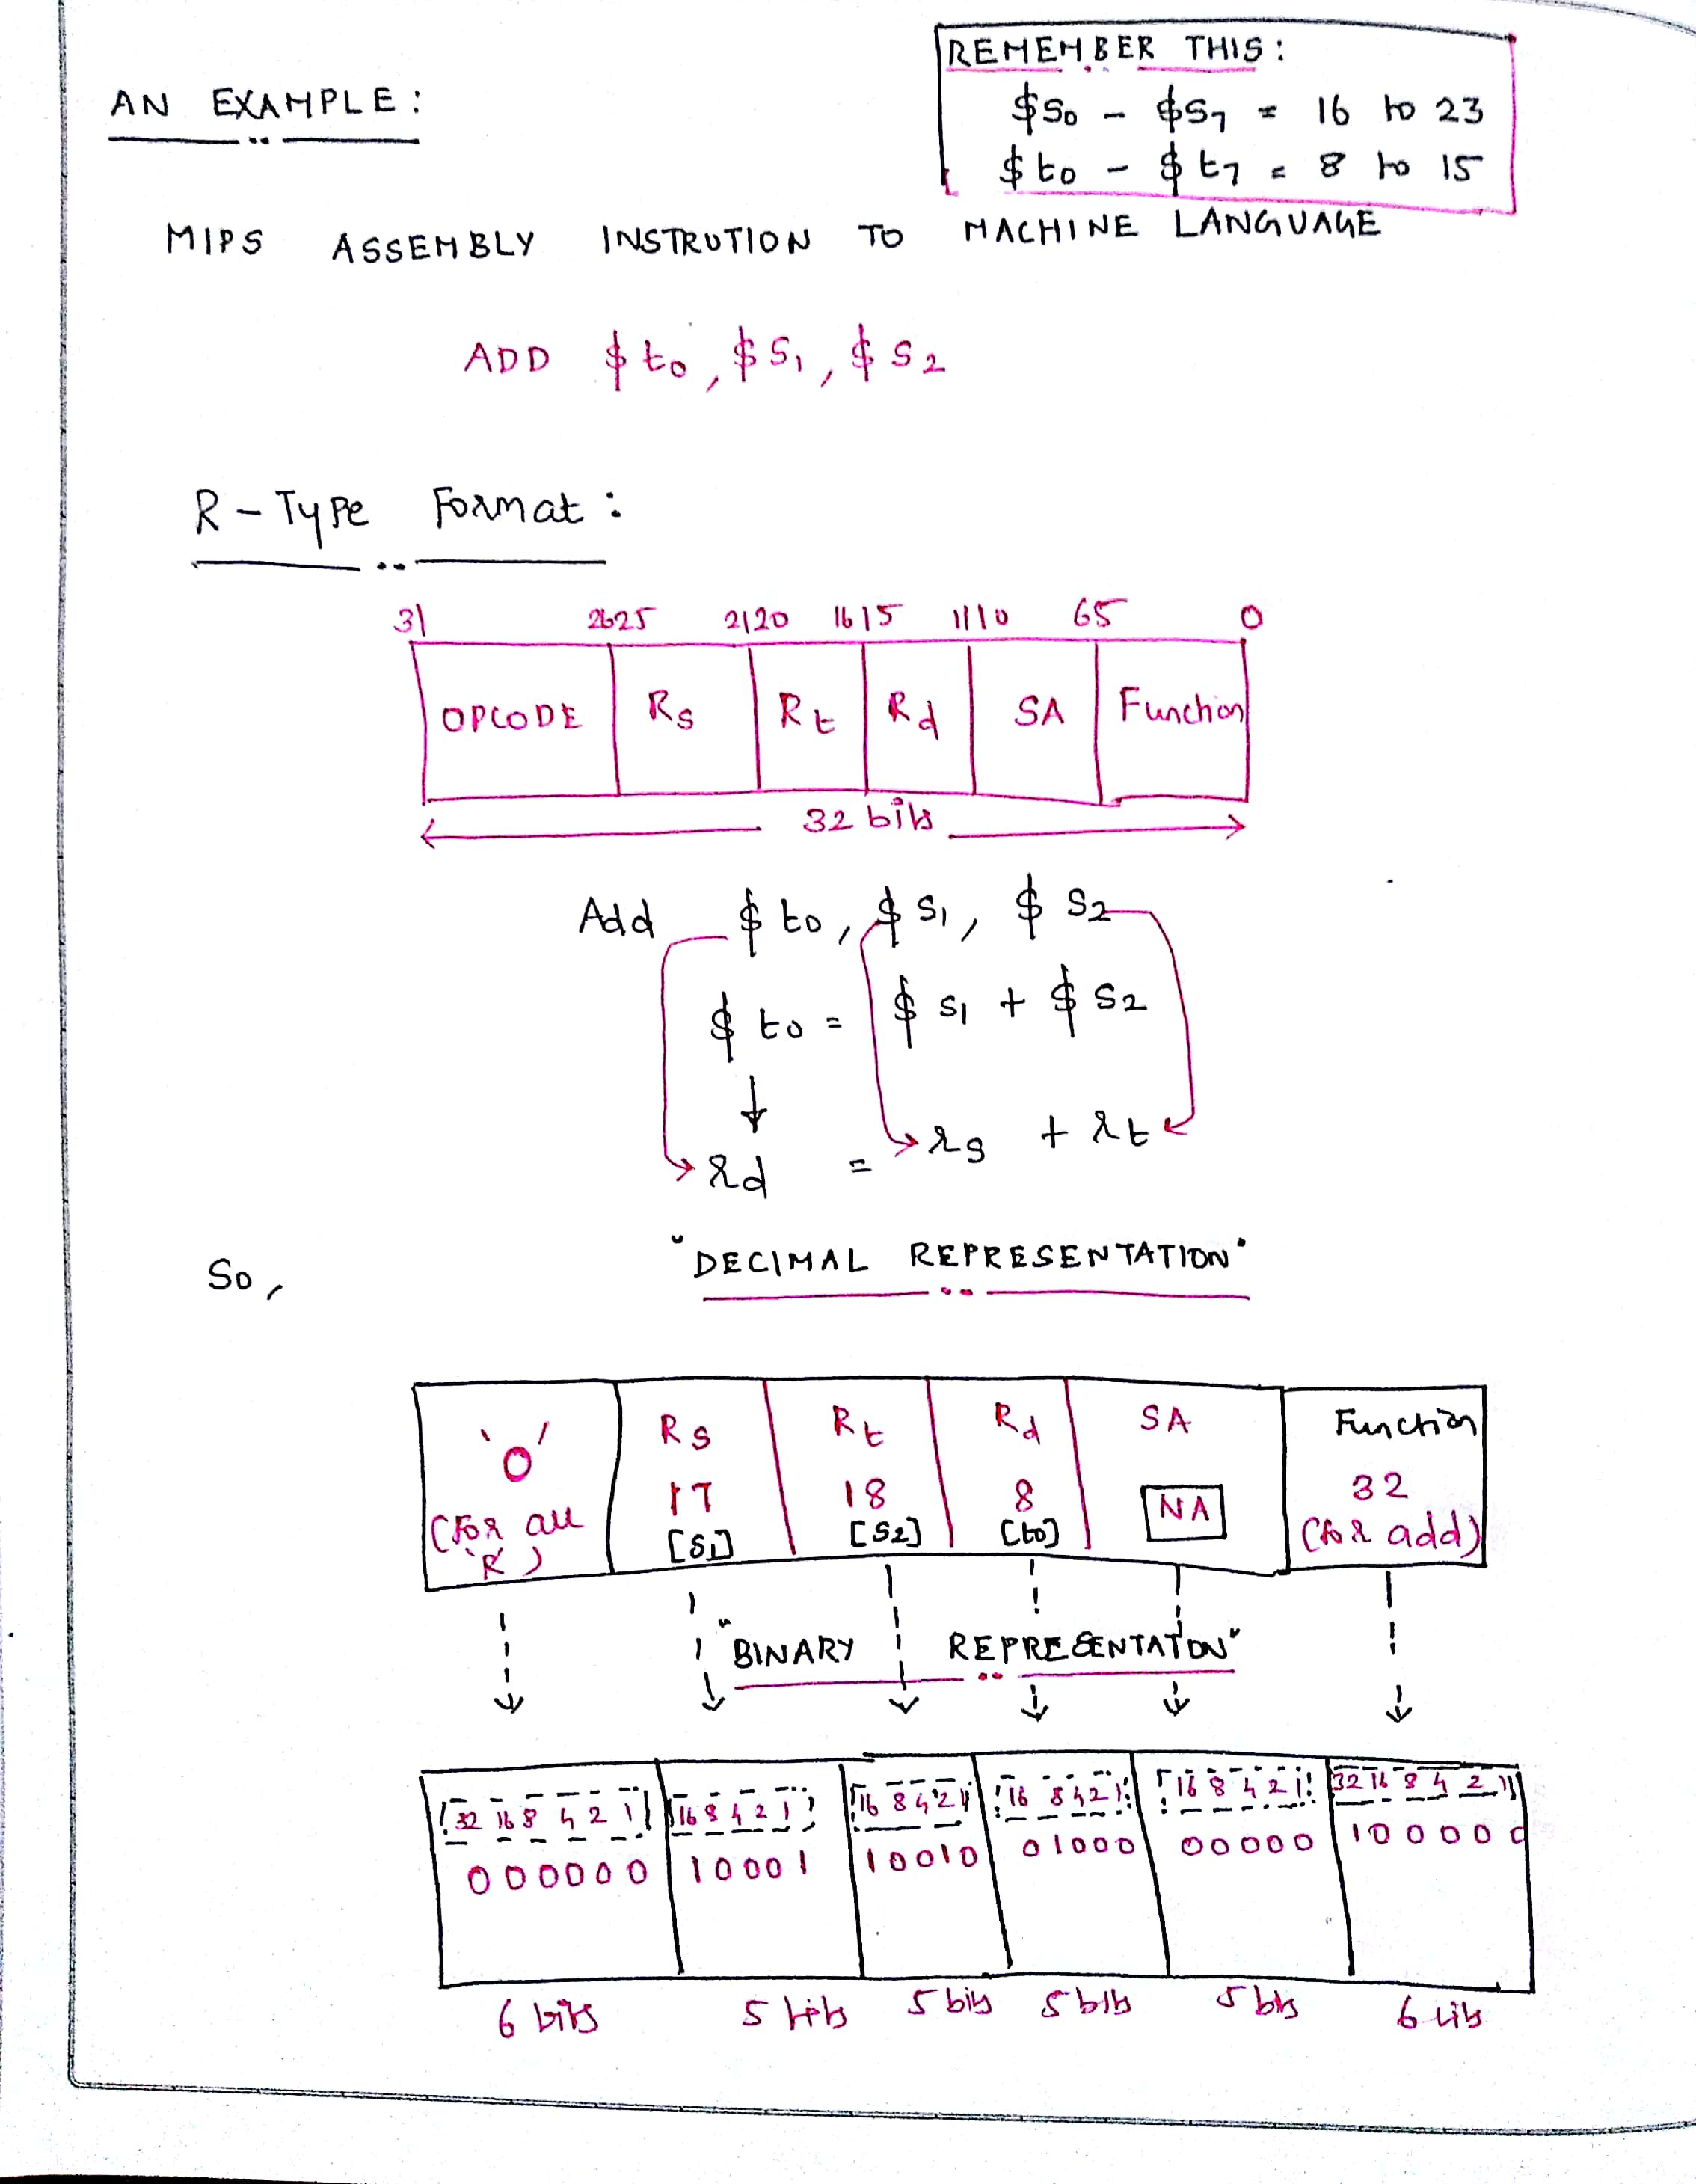
Contd.,
A Simple Home Work!! (Not really folks)

Slide 12
Understand this as well…
Are we and computer the same when we look at a number?
No, Not at all. We are unique!
Humans are capable of thinking everything as base 10 (Decimal).
Computers know only binary (0s and 1s)
25 base 10 = = 11001 base 2. (16 8 4 2 1)
registers $s0 to $s7 map onto registers 16 to 23, and registers $t0 to $t7 map onto registers 8 to 15.

Slide 13
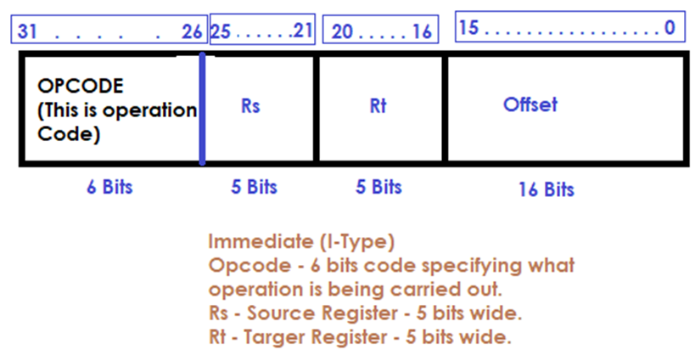
Lets learn I Type Instructions (Once this is done, we are half done)
Load Word and Store Word are the two instructions to be referred under this category.
Load -> Loads the data from the memory location specified to the register.
Store -> Takes the value from the register and stores in the specified memory location.

Slide 14

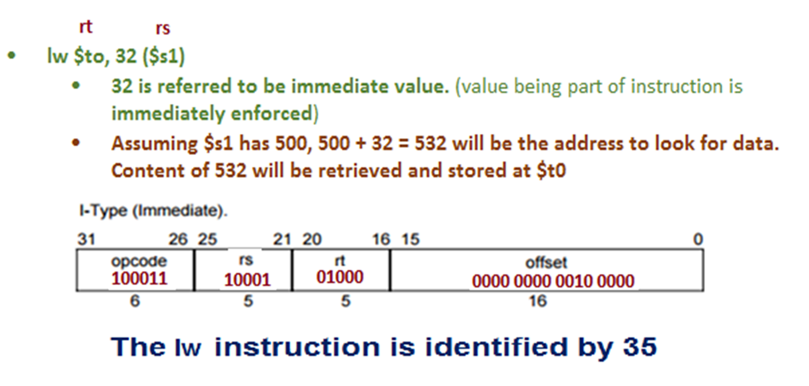
An instance:
lw $to, 32 ($s1)
32 is referred to be immediate value. (value being part of instruction is immediately enforced)
Assuming $s1 has 500, 500 + 32 = 532 will be the address to look for data. Content of 532 will be retrieved and stored at $t0

Slide 15
Lets also know this… Why we need load and store?
C or C P P for an instance support single data elements and complex data elements as well, which include array, structure and union.
How can a computer represent and access such large structures? (Worthy question right??) From COA perspective?
There are limited registers only made available in the processor.
Hence, naturally, very limited information / data can be stored in the registers.
But, a computer may have to handle so much data. Hence, data structures (arrays and structures) are kept in memory.
Arithmetic operations occur only on registers in MIPS instructions;
Thus, MIPS must include instructions that transfer data between memory and registers. Such instructions are called data transfer instructions.
To access a word in memory, the instruction must supply the memory address.
The data transfer instruction that copies data from memory to a register is traditionally called load and vice-versa is referred as store. Hence, we need load and store.

Slide 16
How much important is I TYPE Instruction (addi)
Many times a program will use a constant in an operation—for example, incrementing an index to point to the next element of an array.
An example is precise in this situation:

Slide 17
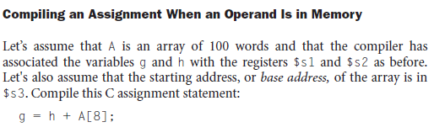
Contd., An Example Again…

Slide 18
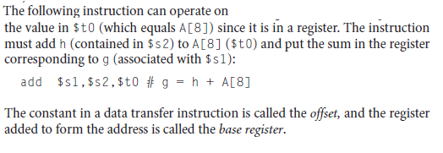
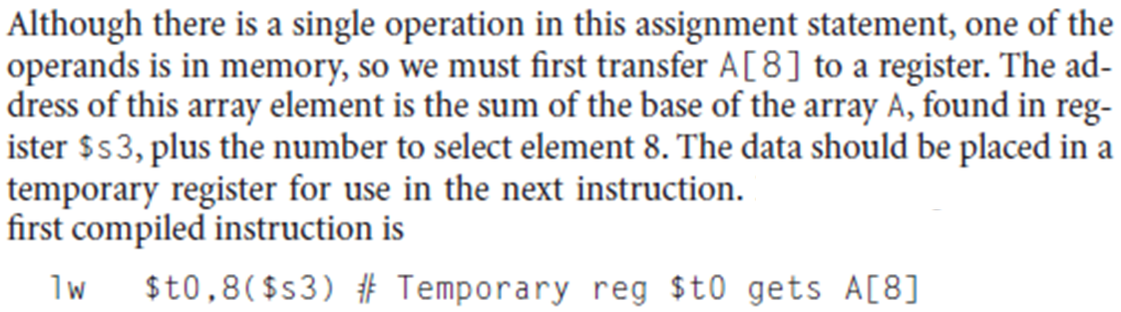
8 * 4 = 32

Slide 19
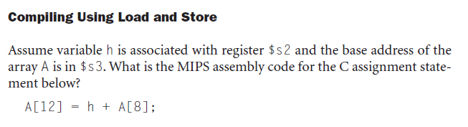
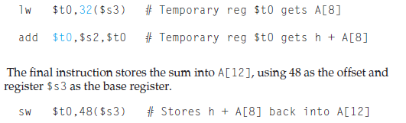
Although there is a single operation in the C statement, now two of the operands are in memory, so we need even more MIPS instructions.
The first two instructions are the same as the prior example, except this time we use the proper offset for byte addressing in the load word instruction to select A[8], and the add instruction places the sum in $t0:
Write the equivalent binary for this.. Work out now.

Slide 20
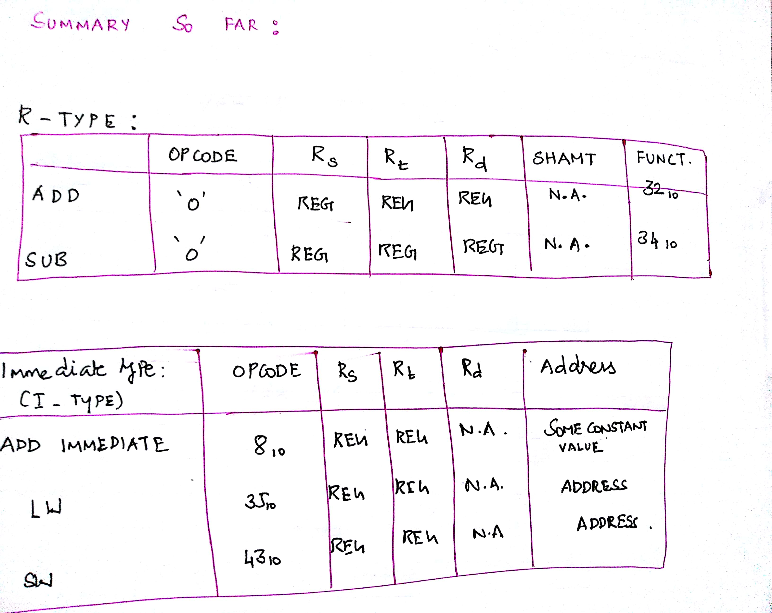
So far.. So good.
Add, Sub and Addi are arithmetic.
LW and SW are Data transfer Instructions.
For add, sub = R Type = Data in registers.
For Addi = Constant addition, to save time.
For Load = Data moved to register from memory
For Store = Data moved to memory from register.

